Slide 1



Analog Electronic Circuits Project
V.Aasrith Reddy
Sai Sampath Ravikanti

Slide 2

Quadrature Oscillator Design

Slide 3
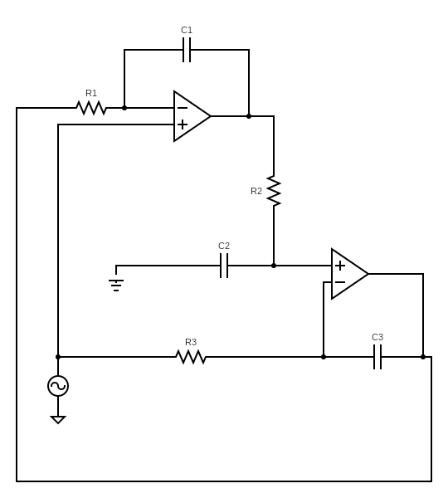
Quadrature Oscillator Design
The Oscillator is designed to produce two Sinusoidal signals at frequency 100KHz and amplitude of 1Vpp at phase difference 90degree .
A noise of small amplitude and frequency of few Hz is applied as input .
Outputs of Operational amplifiers are the required sinusoidal signals.

Slide 4
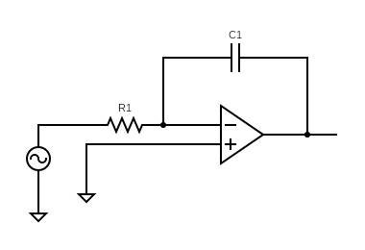
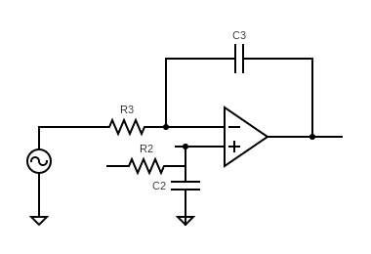
Circuit Analysis
The above circuit can be divided into two small sectors .

Slide 5

Analysis of first part : By applying KVL across the loop and using formula
${\text{V}}_{\text{out}}{\text{=}\text{A}\text{(}\text{V}}_{\text{+}}\text{−}{\text{V}}_{\text{−}}$)
Consider virtual short circuit ➔ $V_{+}=$ 0
$$\frac{V_{out2}}{R_{1}}= \frac{{−V}_{out1}}{\frac{1}{sC_{1}}}$$
$$\frac{V_{out1}}{V_{out2}}(s)= \frac{−1}{sR_{1}C_{1}}$$
Consider A(gain) as 1.

Slide 6

Analysis of Second part : By applying KVL across the loop and using formula
$V_{out}{=A(V}_{+}−V_{−}$)
$$V_{−}= {{V_{out1}}/{sC_{2}}}/{{(R}_{2}+1/{sC_{2}})}$$
$$V_{−}=1/{(1+sR_{2}C_{2})}$$
Considering virtual short of the Op-amp ➔ $V_{+}=1/{(1+sR_{2}C_{2})}$
$$\frac{0−V_{+}}{R_{3}}= \frac{V_{out2}−V_{+}}{1/{sC_{3}}}$$
$$\frac{V_{out2}}{V_{out1}}(s)= \frac{(sR_{3}C_{3}+1)}{sR_{3}C_{3}(sR_{2}C_{2}+1)}$$

Slide 7

Therefore, Overall frequency function is
$$Aβ=\frac{−(sR_{3}C_{3}+1)}{sR_{1}C_{1}sR_{3}C_{3}(sR_{2}C_{2}+1)}$$
Consider case where $R_{1}C_{1}{=R}_{2}C_{2}=R_{3}C_{3 }=RC$
$Aβ= \frac{−1}{{(sRC)}^{2}}$
Therefore, for our Requirement
$ω=1/{RC}=⇒f= 1/{2πRC}$

Slide 8

Values Chose
$f= 1/{2πRC}$
Let’s Consider a Capacitor C = 1nF . From the above equation we get R = 1591Ω to oscillate at frequency of 100KHz.
But after stimulation we get to Know for 1V amplification we require $R_{2}=15.9Kohm$ and $C_{2}=0.1nF$

Slide 9


LTSpice Stimulations
Quadrature Oscillator Design

Slide 10
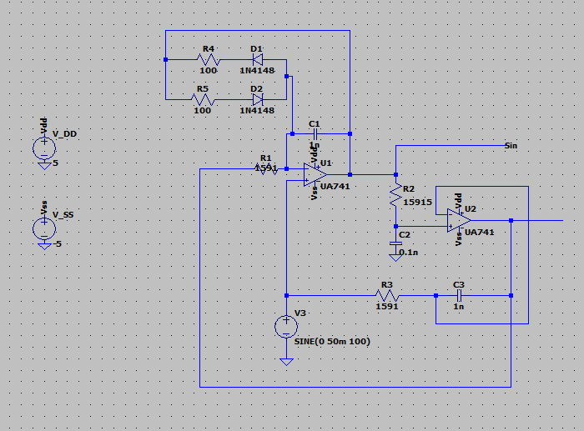

Slide 11
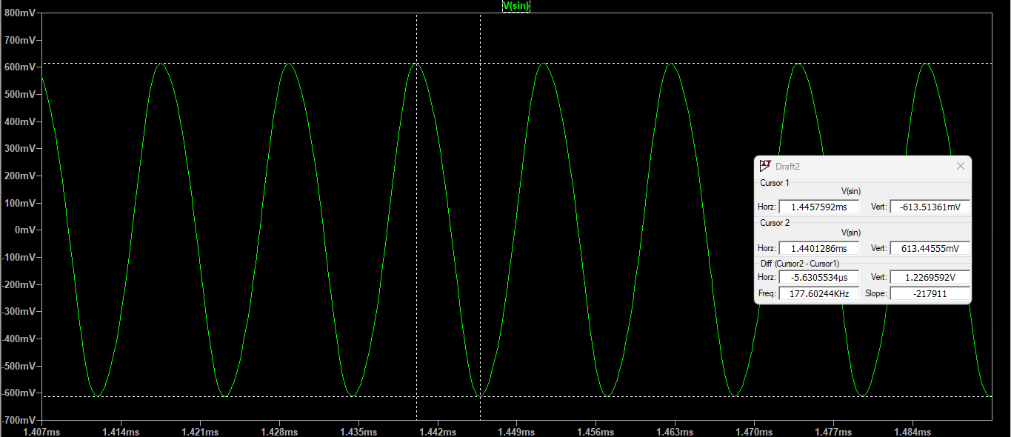

Plot Of $v_{osc1} (Amplitude)$

Slide 12


Plot Of $v_{osc1} (Frequency)$

Slide 13
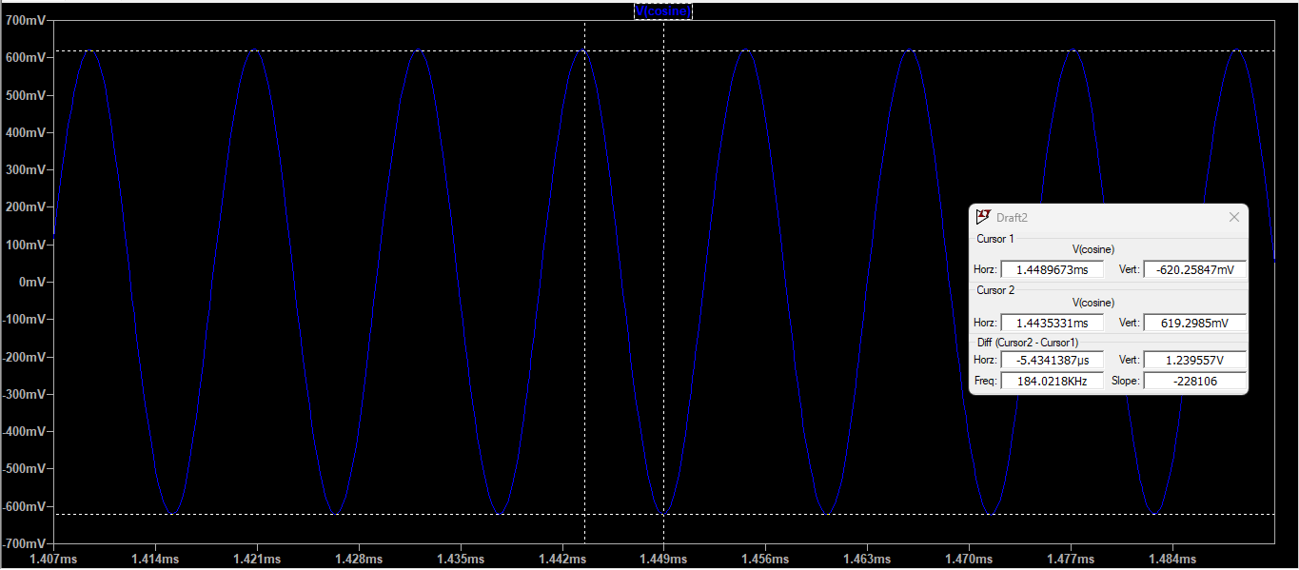

Plot Of $v_{osc2}$ $(Amplitude)$

Slide 14
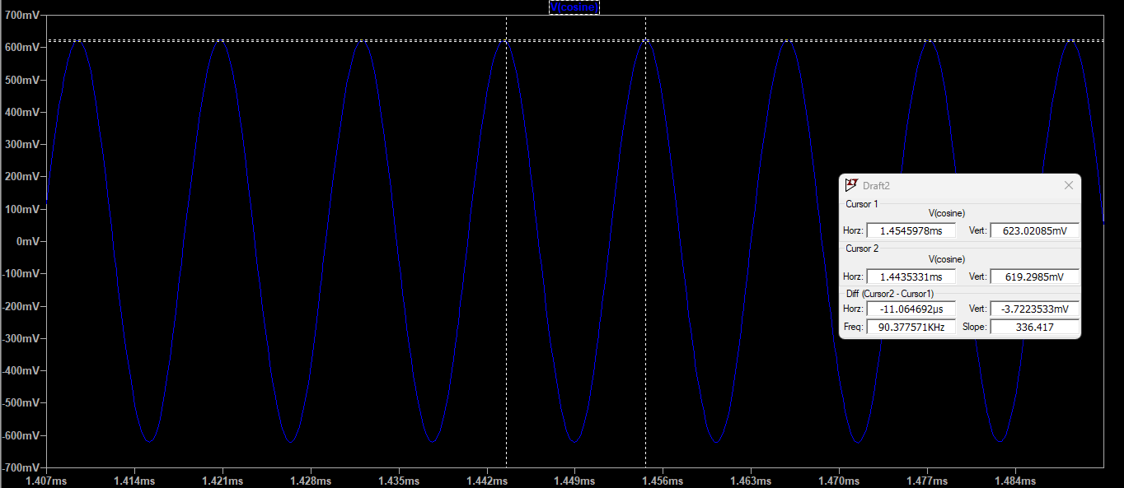

Plot Of $v_{osc2}$ $(Frequency)$

Slide 15
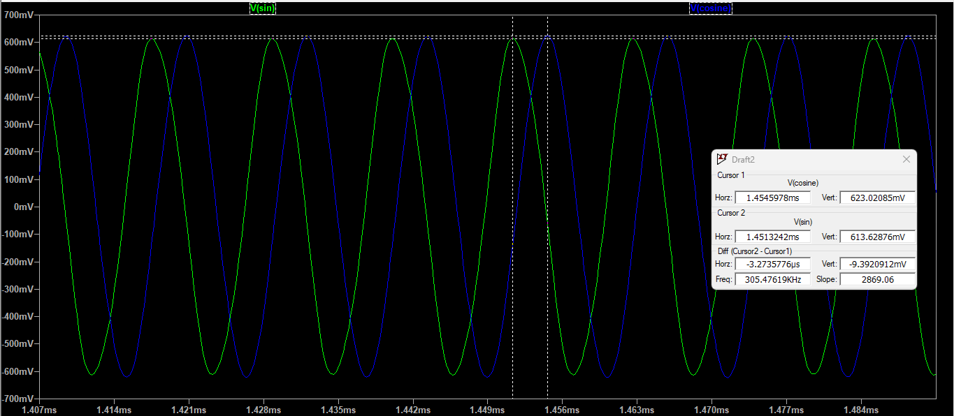


Slide 16
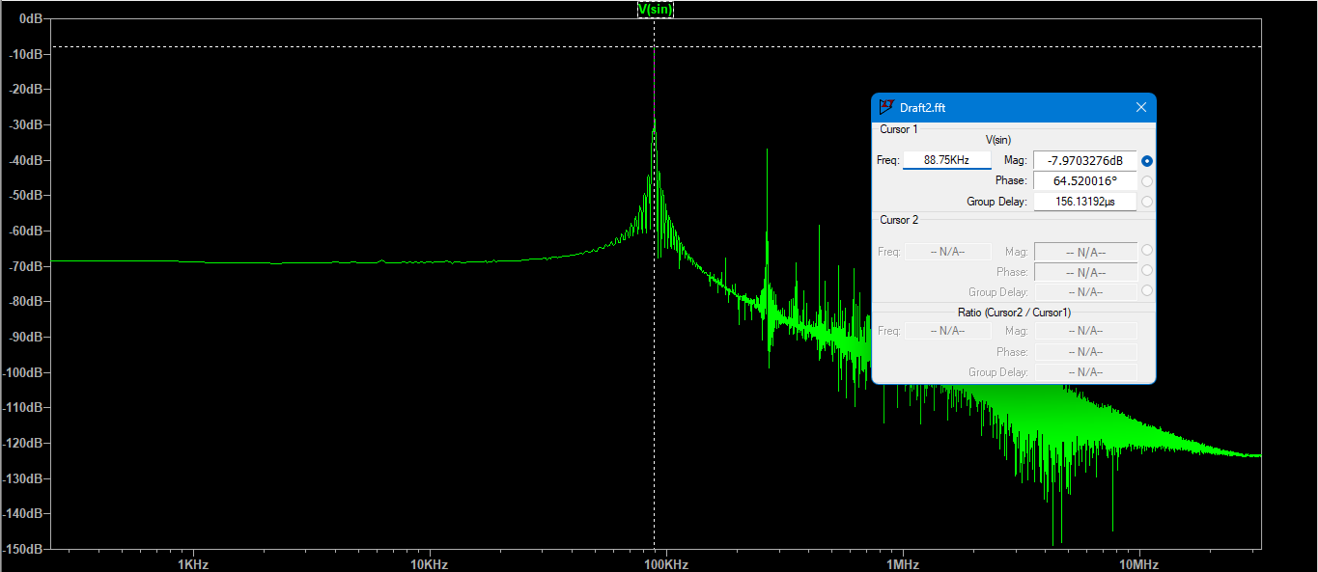

FFT Plot Of $v_{osc1}$

Slide 17
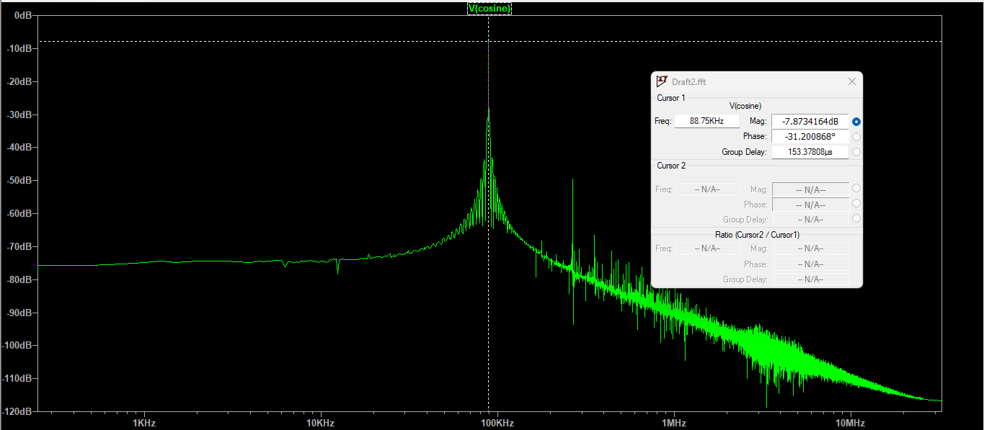

FFT Plot Of $v_{osc2}$

Slide 18
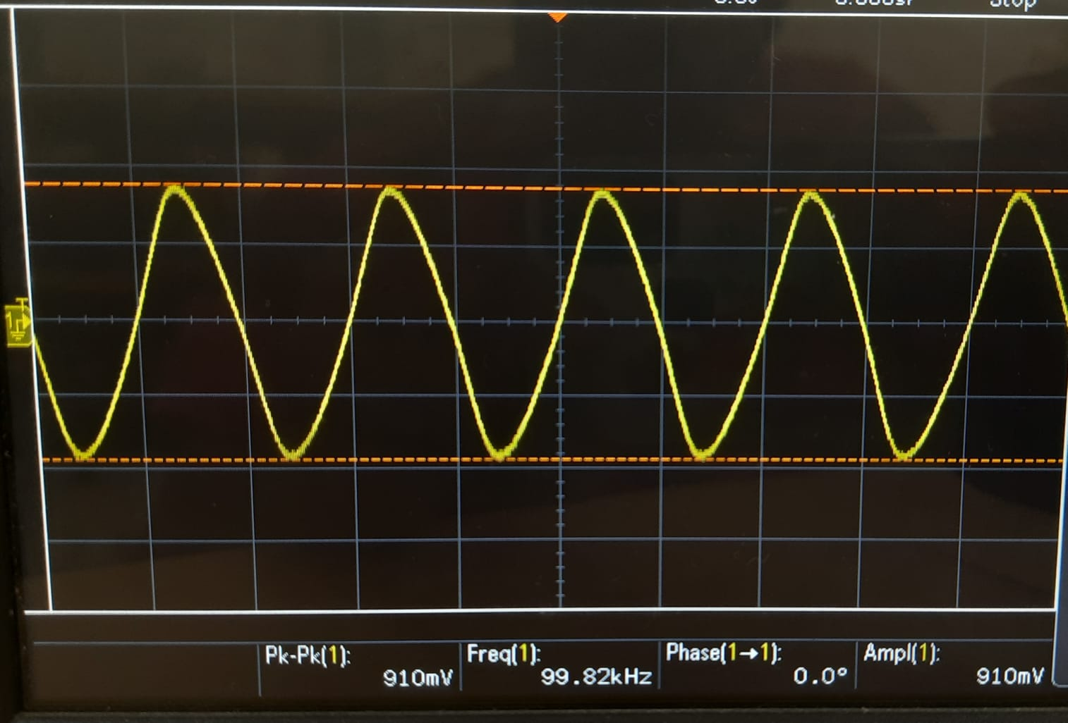

Slide 19
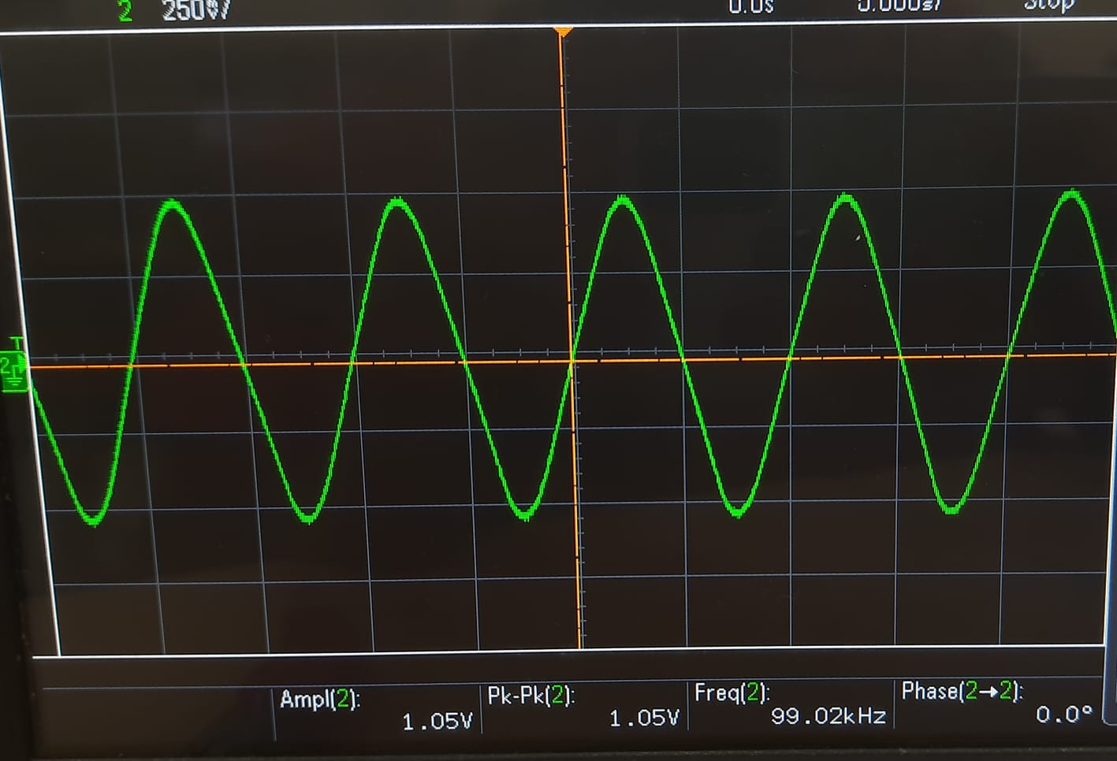

Slide 20
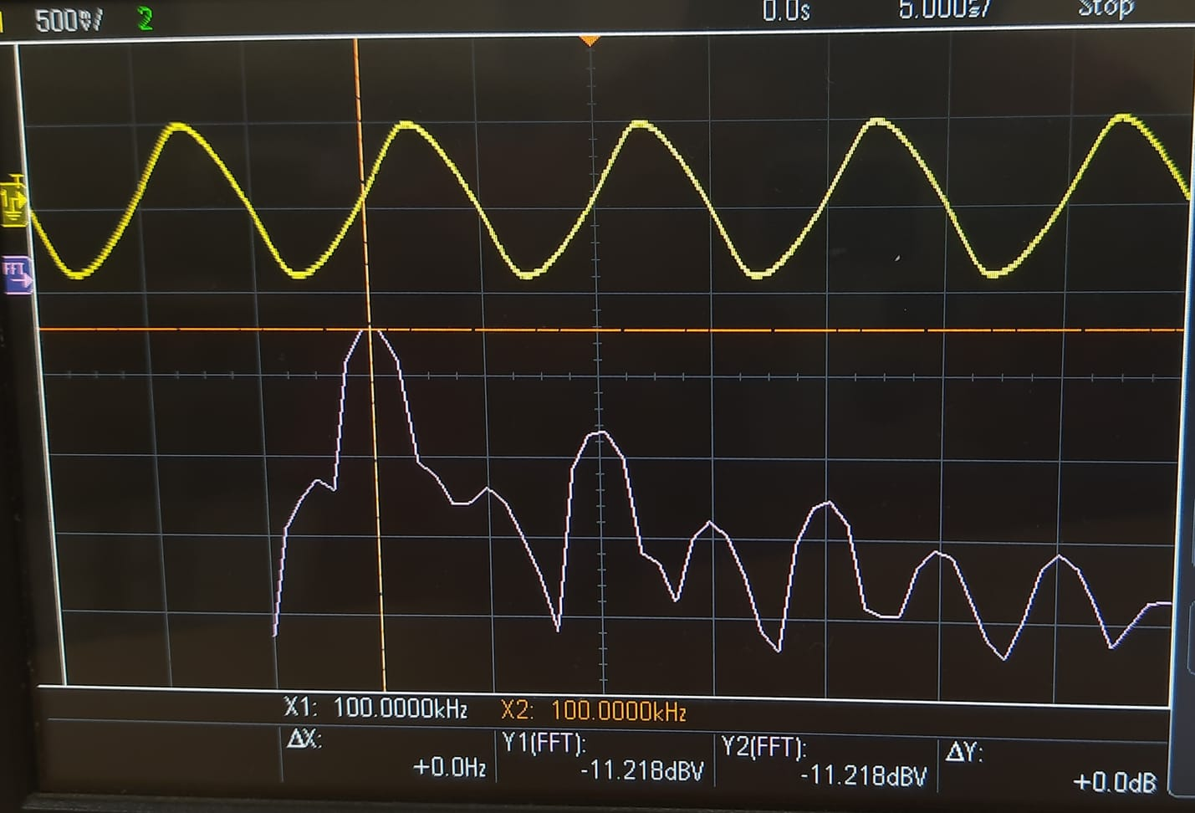

Slide 21
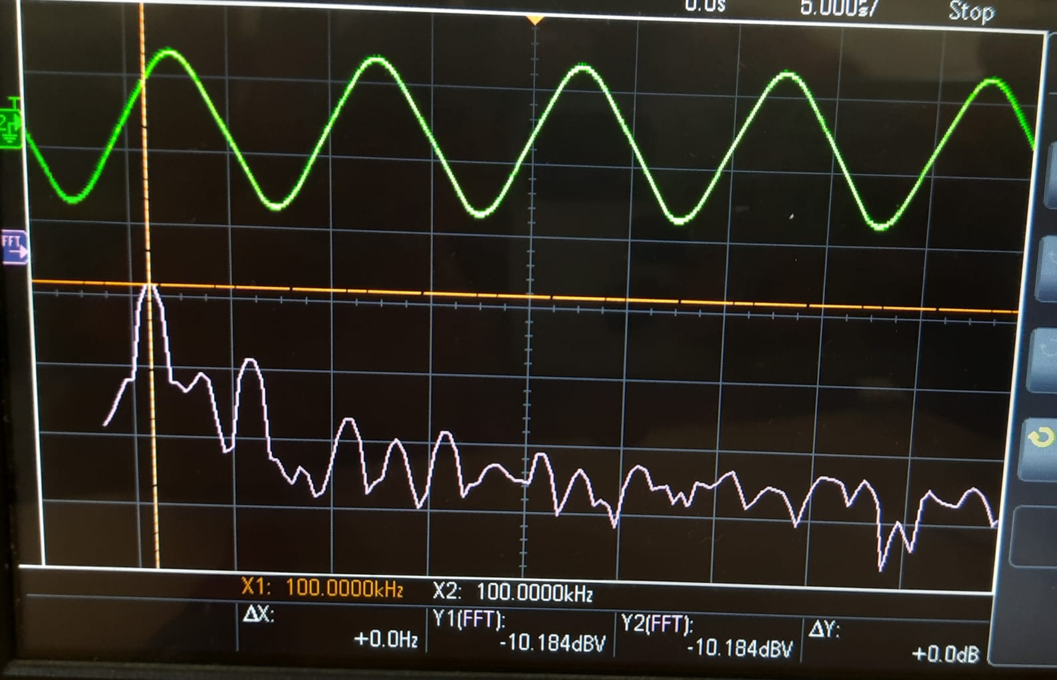

Slide 22
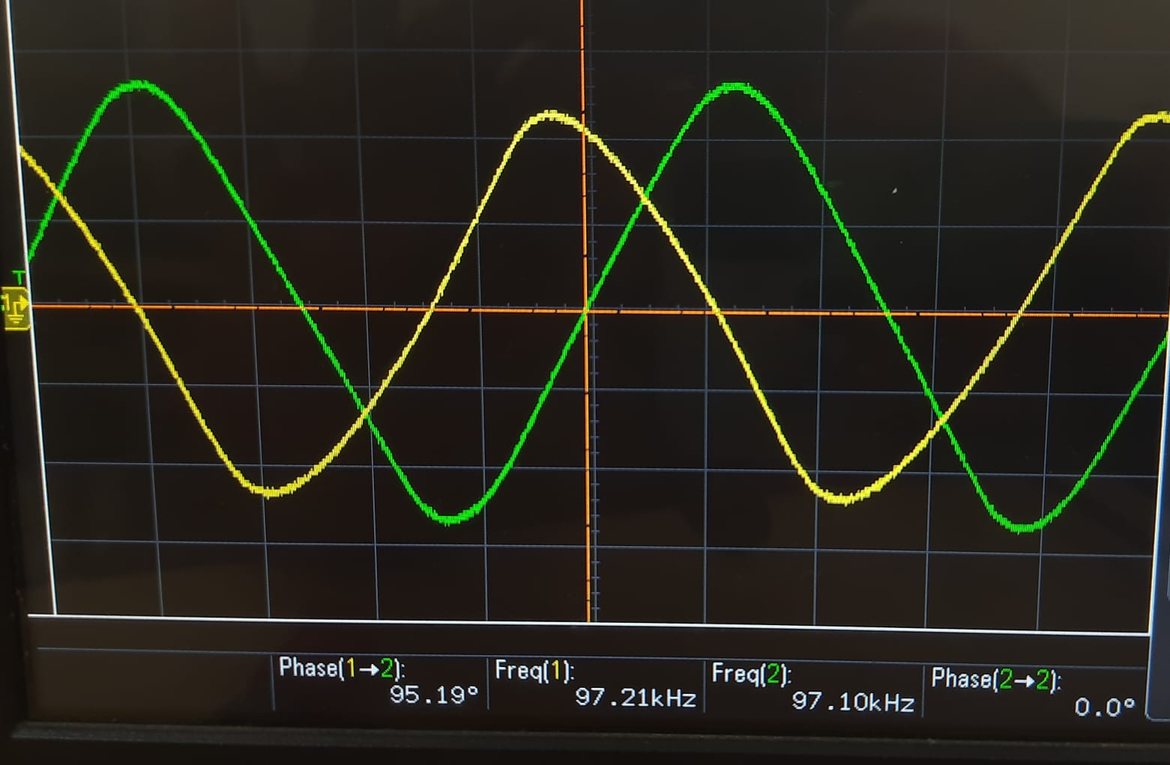

Slide 23
Observed Phase Difference
93.4593

Slide 24
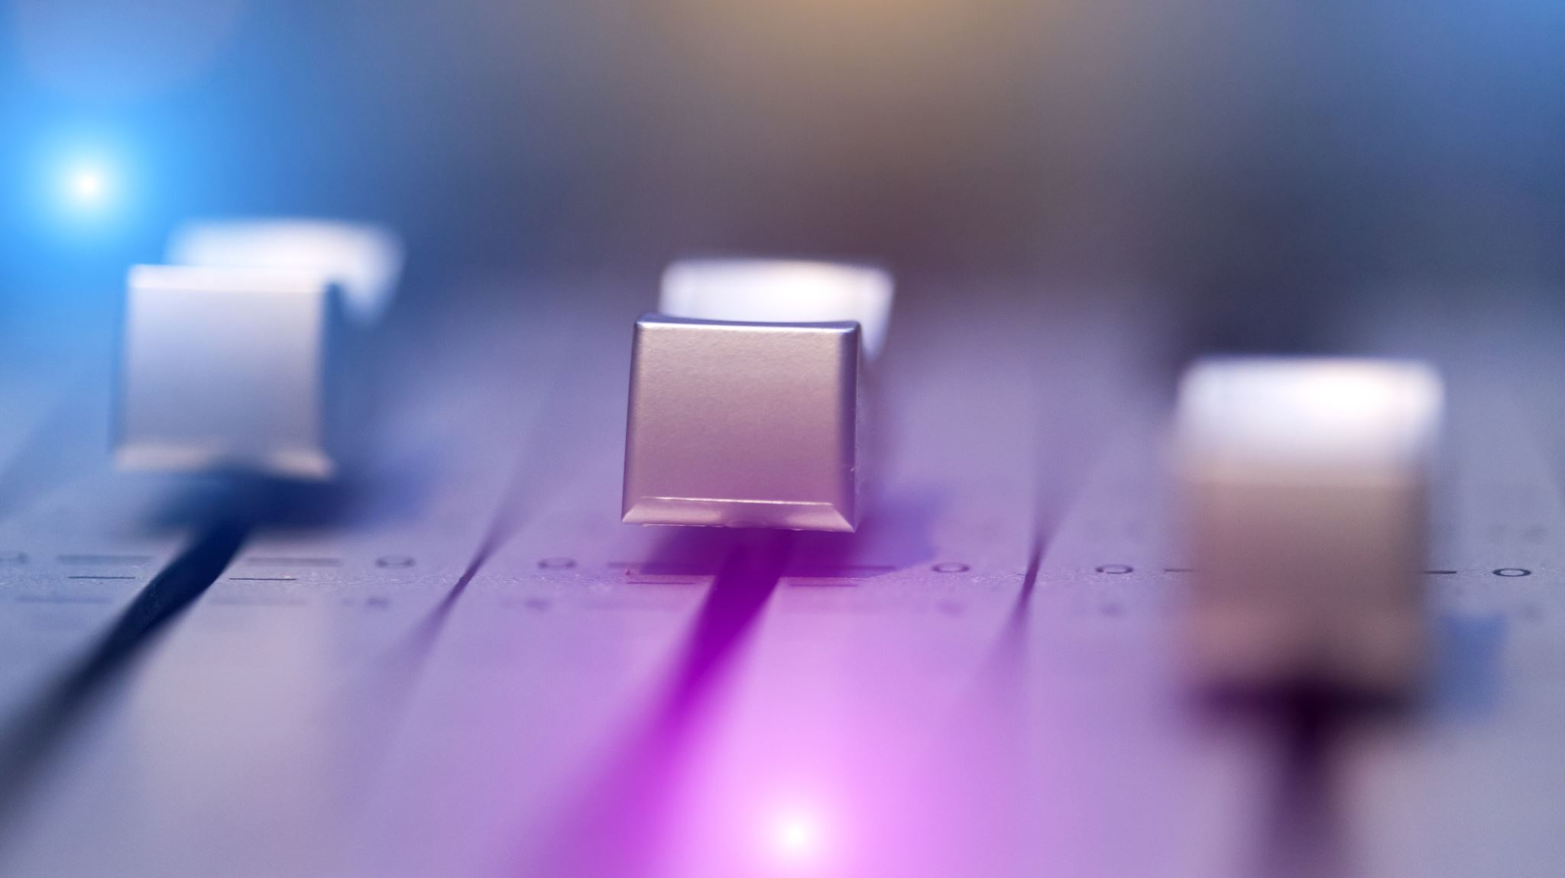
Mixer Circuit

Slide 25
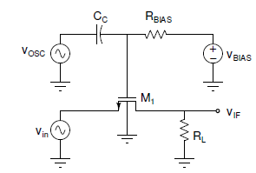

Mixer Circuit
We characterized the MOSFET such that it operates in the Triode Region
$V_{g}=V_{BIAS}+V_{OSC}$
$V_{s}=V_{in}$
$V_{gs}− V_{TH}=V_{BIAS}+$ $V_{OSC}$ - $V_{in}$ - $V_{TH}$
Considering, $V_{BIAS}=$ $V_{TH}$
$V_{gs}− V_{TH}$= $V_{OSC}$ - $V_{in}$

Slide 26

If $V_{OSC}$ - $V_{in} <0$ ➔ $I_{DS}=0$
Then MOSFET will be in Cut-off Region
If $V_{OSC}$ - $V_{in} >0$
Then MOSFET will be in Triode Region
Note that the MOSFET will never be in Saturation Region
$V_{OSC}$ >> $V_{in}$ >> $V_{out}$
$V_{DS}$ - $V_{in}= V_{out}$ - $V_{BIAS}$ - $V_{OSC}$ < - $V_{BIAS}$
For a MOSFET to be in saturation $V_{DS}$ > $V_{gs}− V_{TH}$ ; which is not getting satisfied in the circuit.
$I_{DS}= μ_{n}C_{OX}\frac{W}{L}\left(\left(V_{gs}− V_{TH}\right)V_{DS}−V_{DS}∗\frac{V_{DS}}{2}\right)=k\left(\left(V_{gs}− V_{TH}\right)V_{DS}−V_{DS}∗\frac{V_{DS}}{2}\right)$
$V_{out}$ = $I_{DS}R_{L}$ = $kR_{L}\left(\left(V_{gs}− V_{TH}\right)V_{DS}−V_{DS}∗\frac{V_{DS}}{2}\right)=kR_{L}\left(\left(V_{OSC}\text{ − }V_{in}\right)\left(V_{out}+V_{in}\right)−\frac{{\left(V_{out}+V_{in}\right)}^{2}}{2}\right)$
After few approximations ; $V_{OSC}$ >> $V_{in}$ >> $V_{out}$
$V_{out}=kR_{L}V_{OSC}$ $V_{in}$

Slide 27

Values Chose
From LTSpice we get to Know $V_{TH}=0.47V$. For the switch to we need to switch the Mode of MOSFET from Cut-off and Triode region . From $I_{DS}$ Vs $V_{gs}$ , we can observe than we DC biased of gate is close to $V_{TH}$ . Upon which a small signal is applied, for negative half it enters cut-off mode and positive half in positive half .
Therefore, $V_{BIAS}$ = 0.55V
$V_{gs}= \frac{R_{BIAS}}{(R_{BIAS}+\frac{1}{sC_{1}})}$ $V_{in}$
Here Resistor and capacitor act as High-pass filter so we require high Resistor say 10MΩ which implies capacitance as 10µF . Since based on bode-plot we expect -3dB frequency to be 100KHz
$\frac{1}{2πRC}=100K$

Slide 28
LTSpice Stimulations
Mixer Design

Slide 29
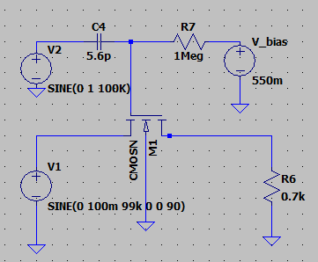

Slide 30
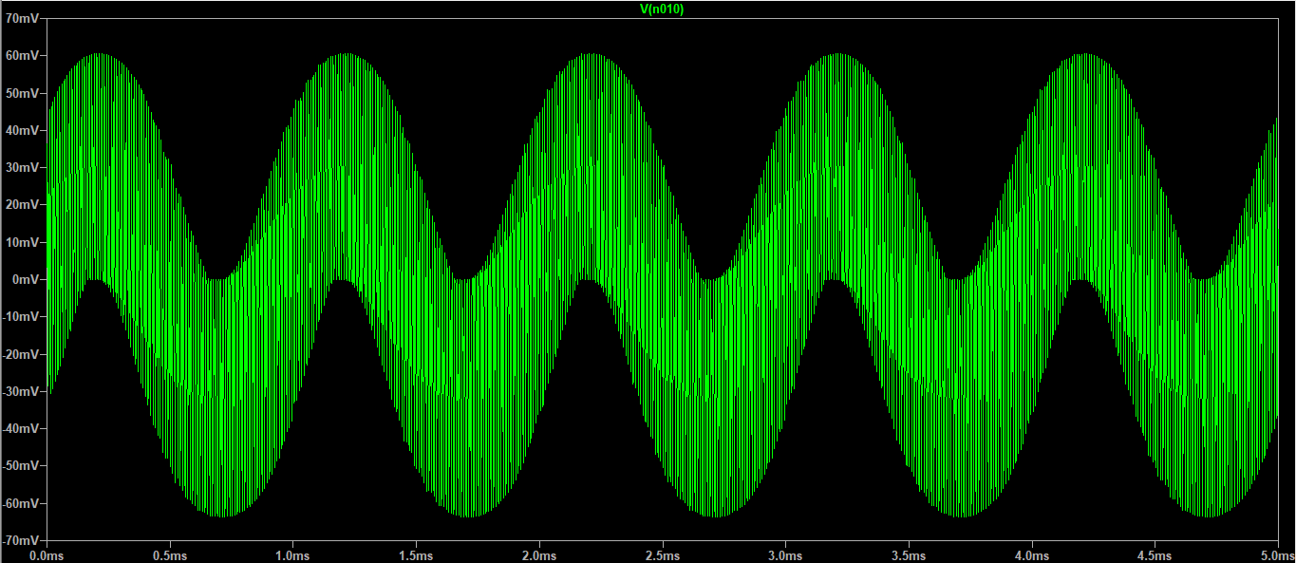
Plot Of Vout

Slide 31
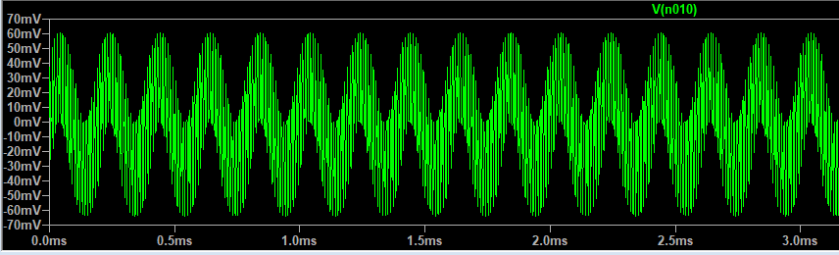
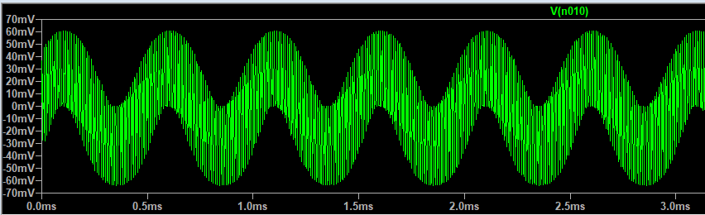
Plot Of Vout Varying Frequency
95KHz
98KHz

Slide 32
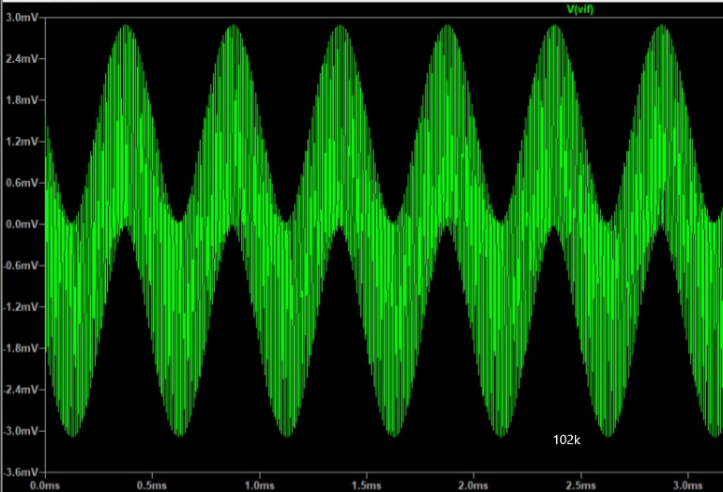
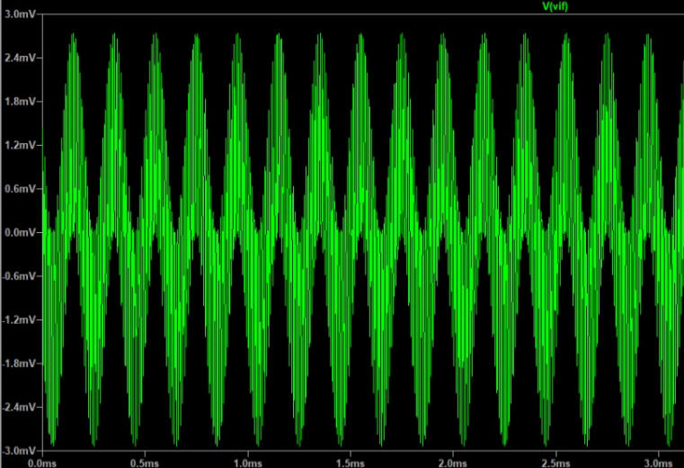
Plot Of Vout Varying Frequency
102KHz
105KHz

Slide 33
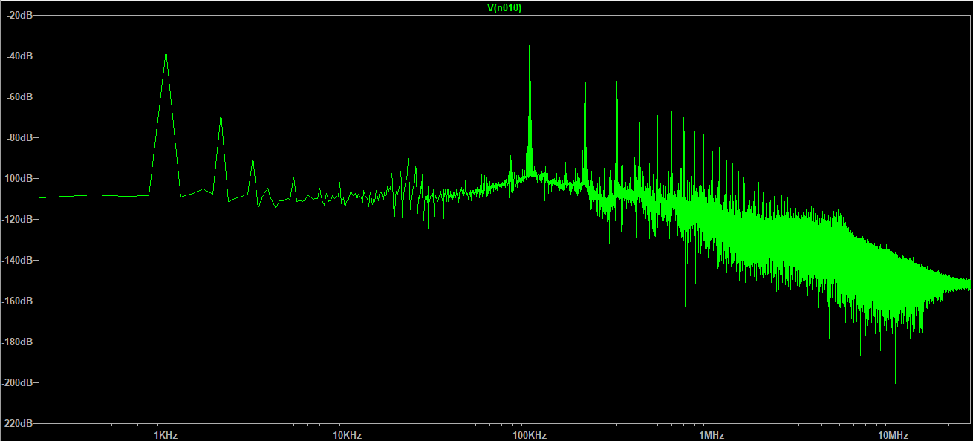
FFT Plot

Slide 34
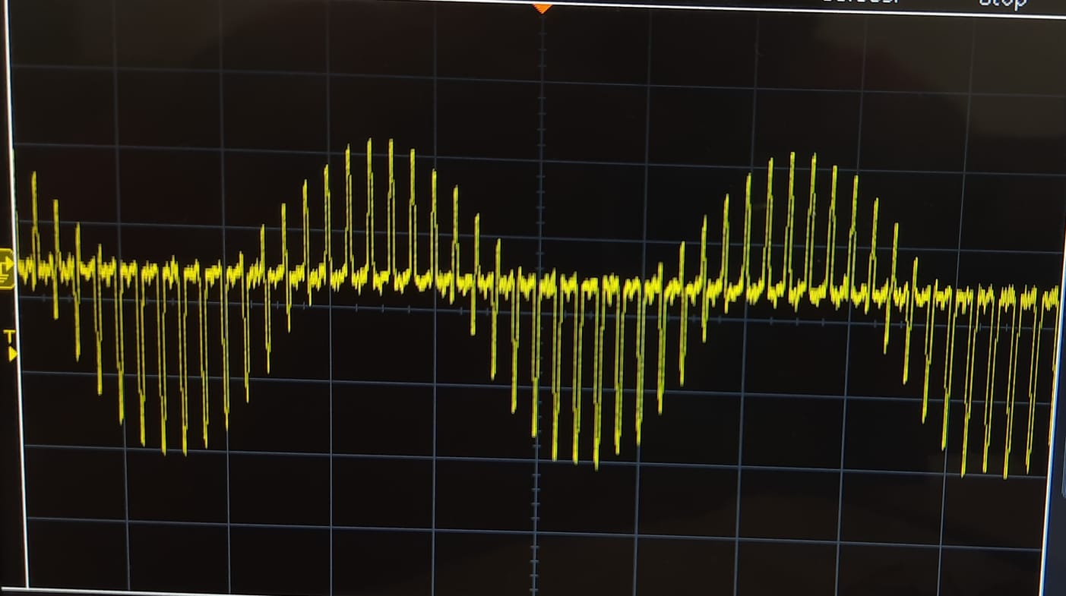

Slide 35
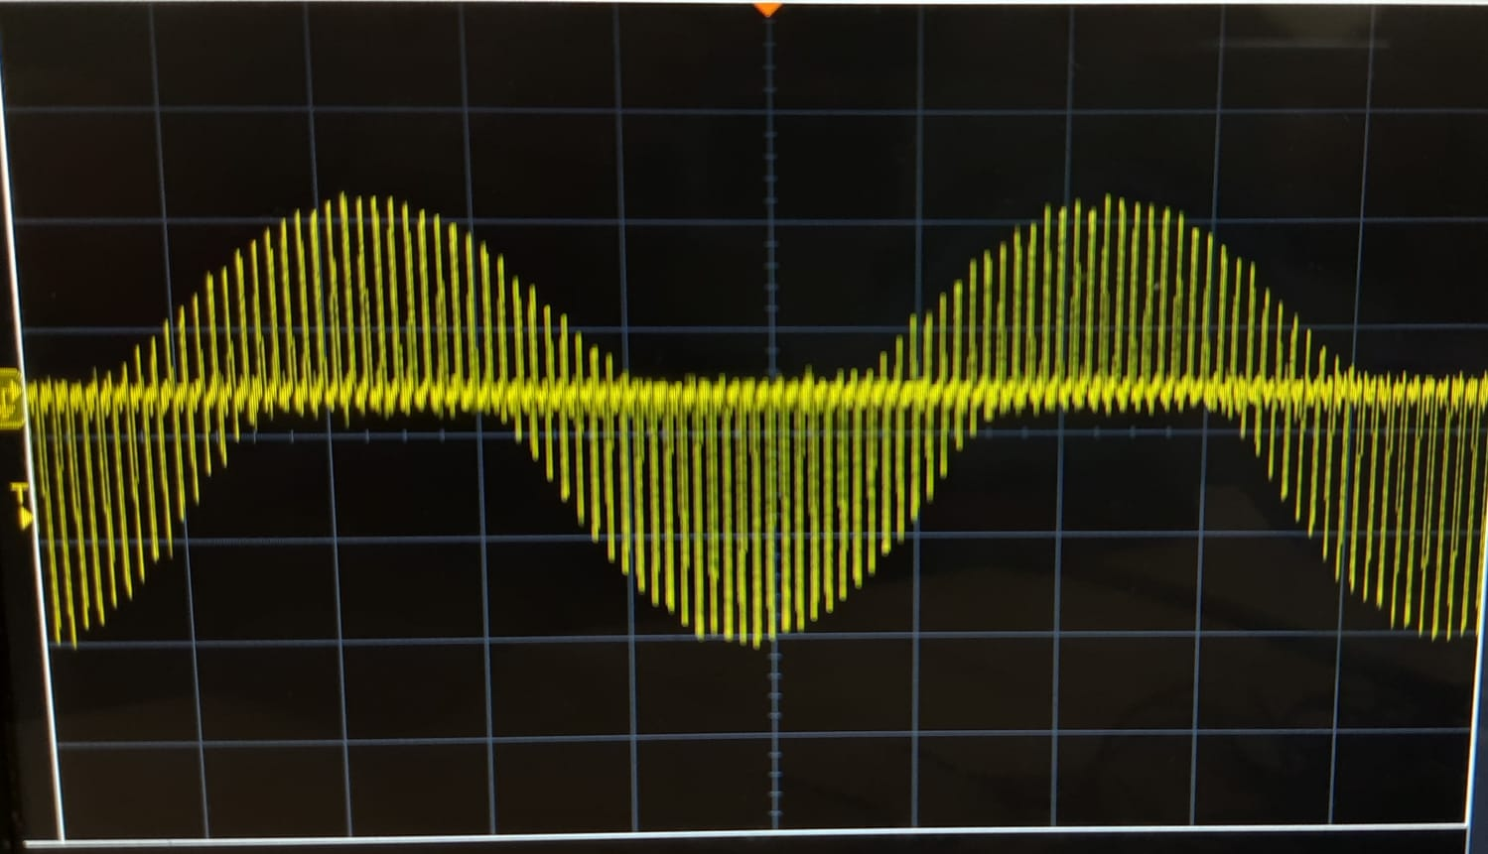

Slide 36
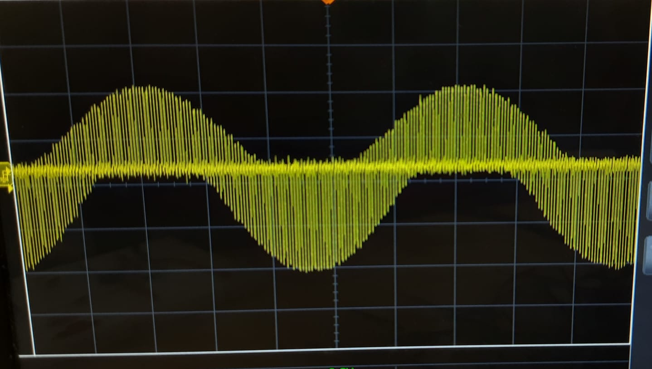

Slide 37

Low Pass Filter

Slide 38

Low PASS FILTER
A low pass RC filter (LPF) with -3 dB cut off frequency of 2 kHz can be obtained by considering Resistors and Capacitor satisfying relation $\frac{1}{2πRC}=$ 2K
Considering R = 100Ω and C = 0.79µF = 790nF

Slide 39
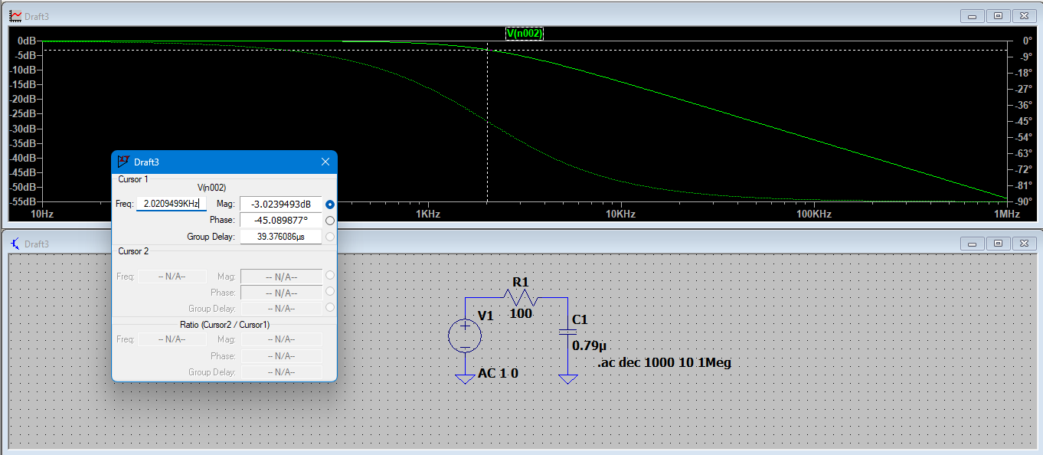

Slide 40
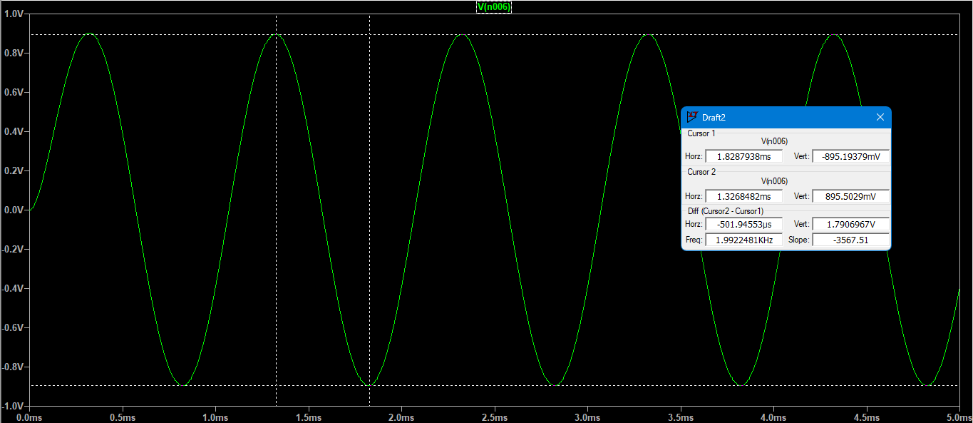
Transient Response Of 1KHz

Slide 41
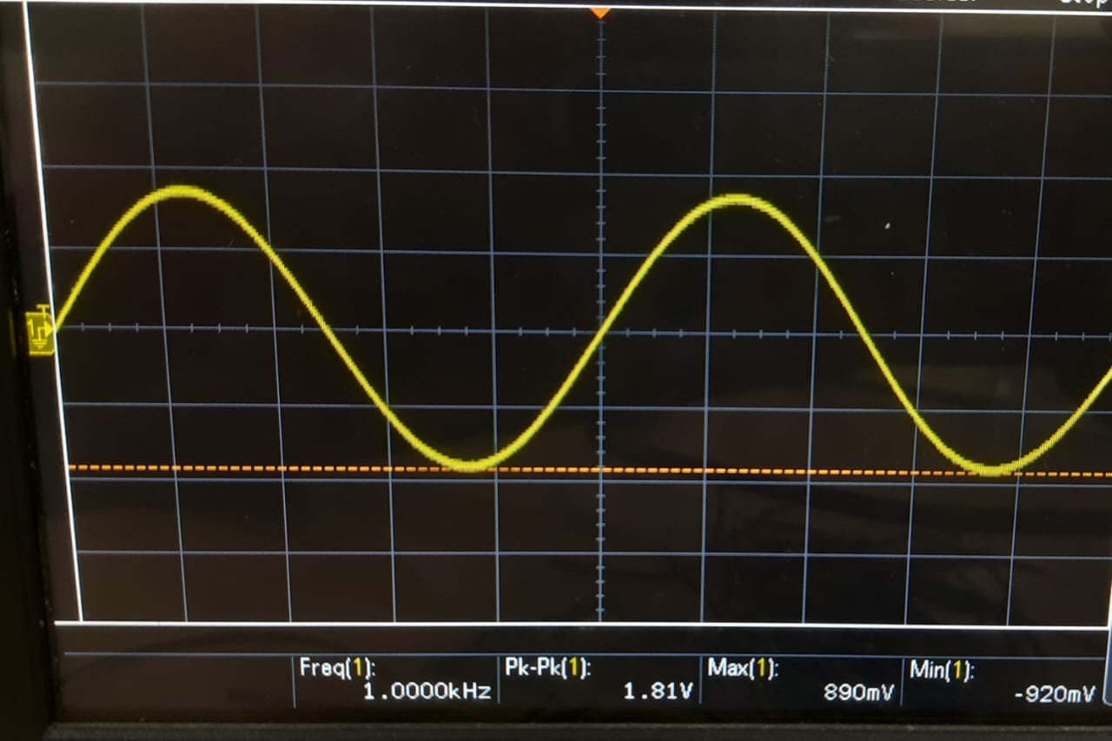

Slide 42
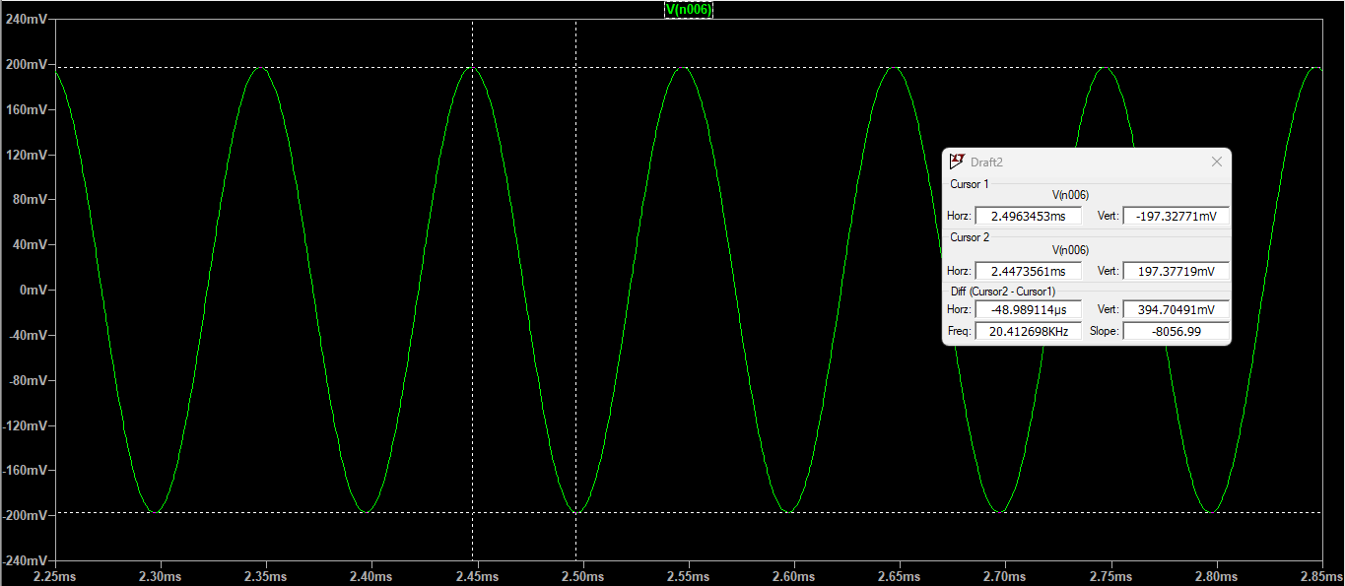
Transient Response Of 10KHz

Slide 43
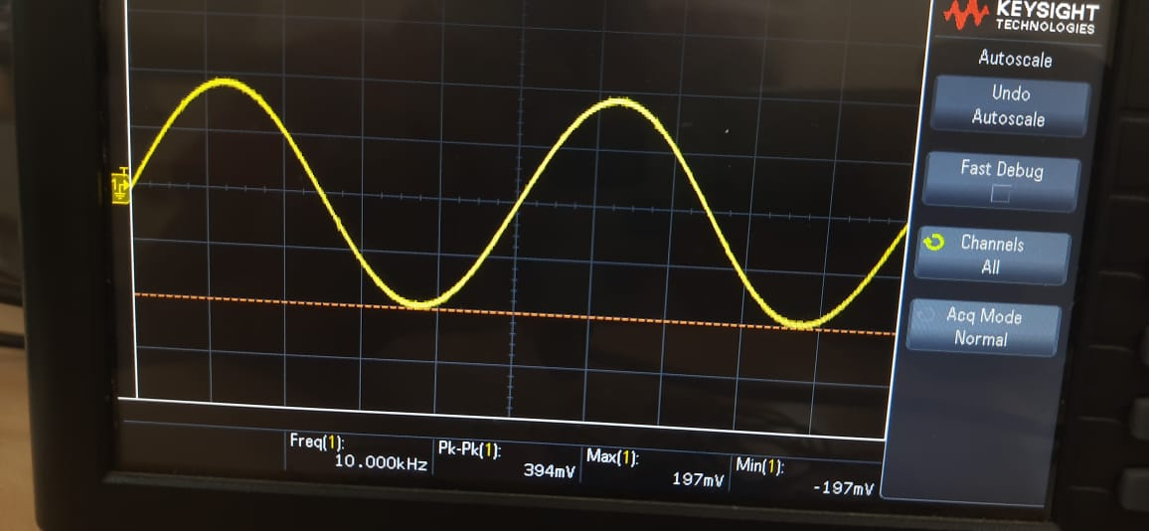

Slide 44

Combination Of Mixer And LPF

Slide 45
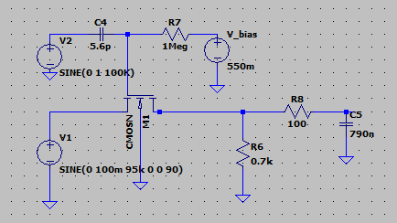

Slide 46
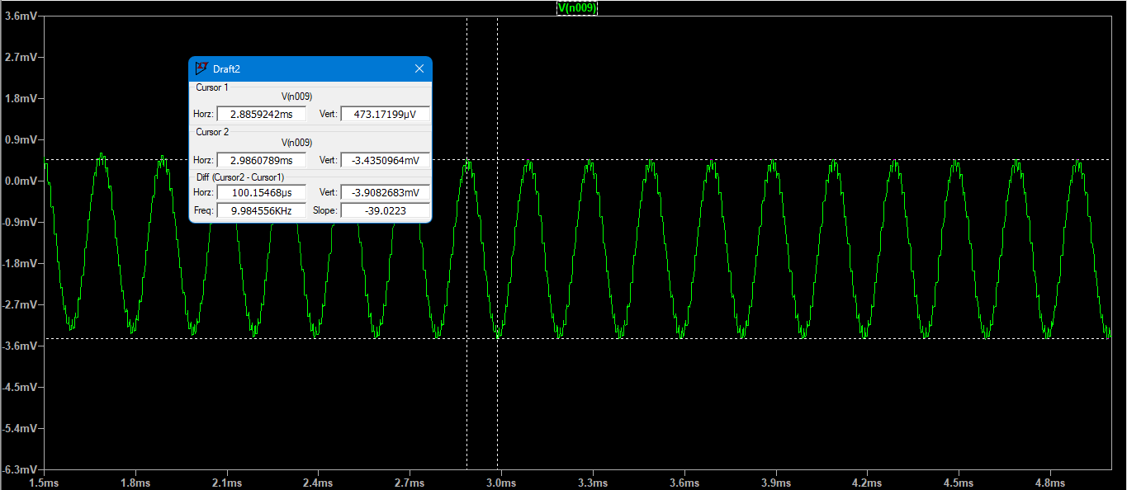

Slide 47
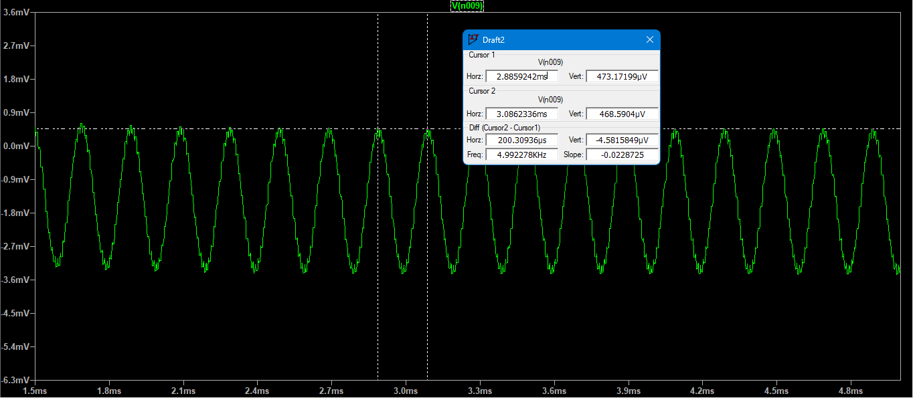

Slide 48

Overall Circuit

Slide 49
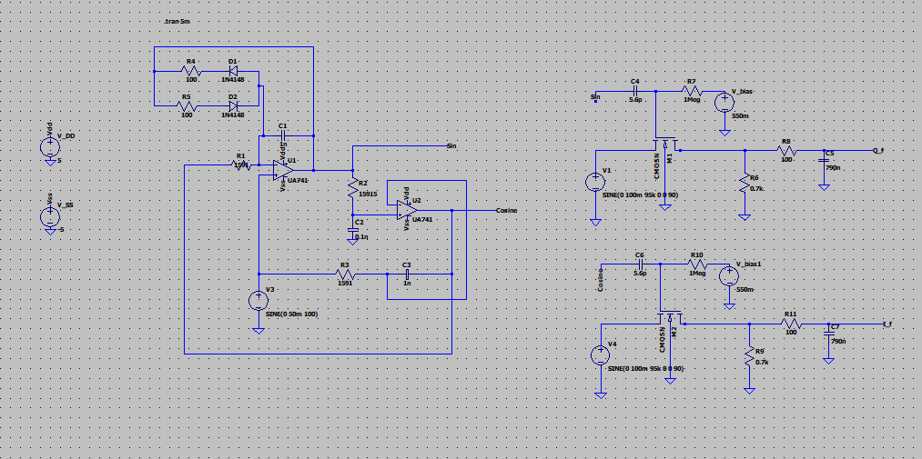

Slide 50
Sine Plot of Oscillator

Slide 51
Cosine Plot of Oscillator

Slide 52
Sine Plot of Oscillator

Slide 53
Cosine Plot of Oscillator

Slide 54
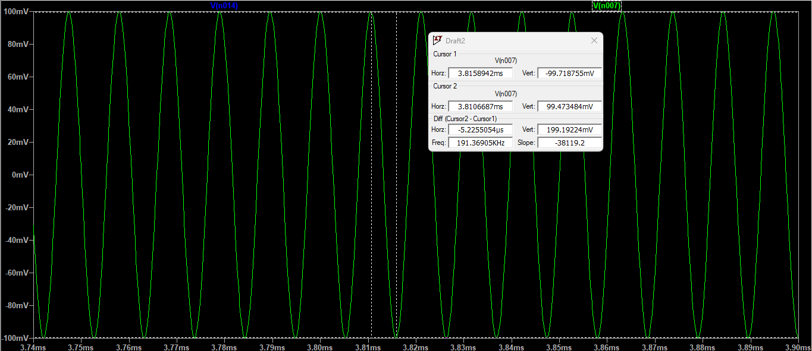
Input Signal

Slide 55
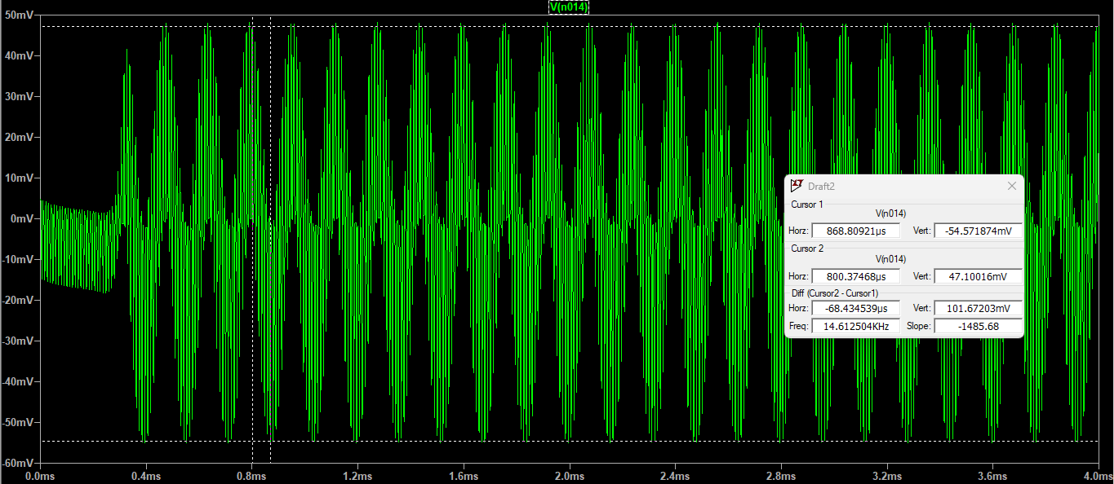
Intermediate If Signal(Amplitude)

Slide 56
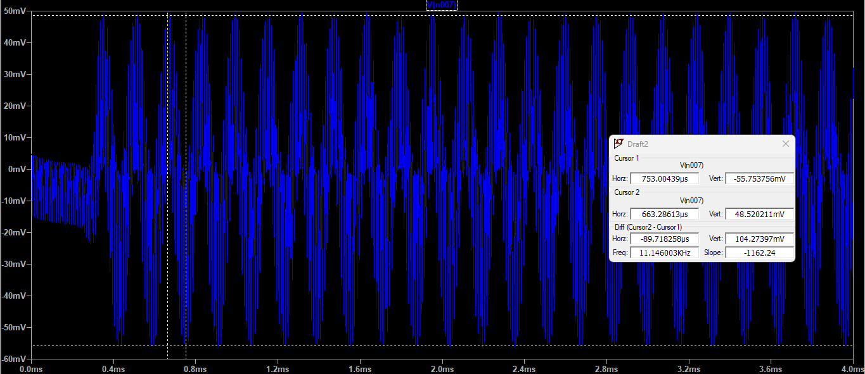
Intermediate Qf Signal(Amplitude)

Slide 57
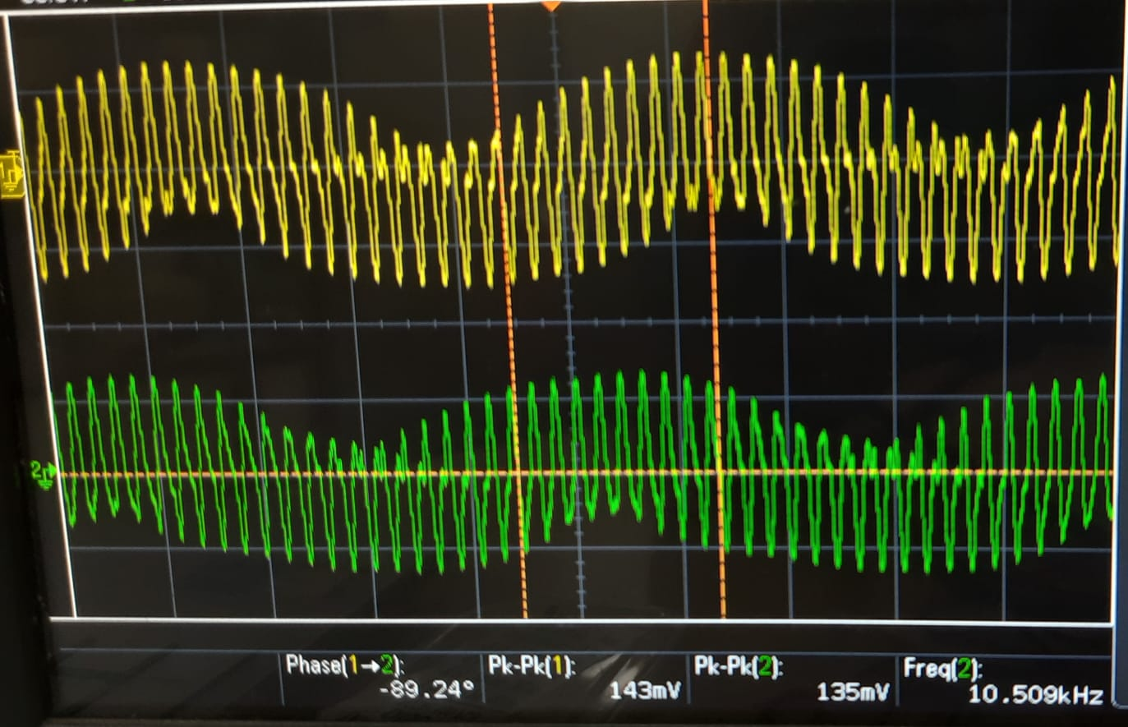

Slide 58
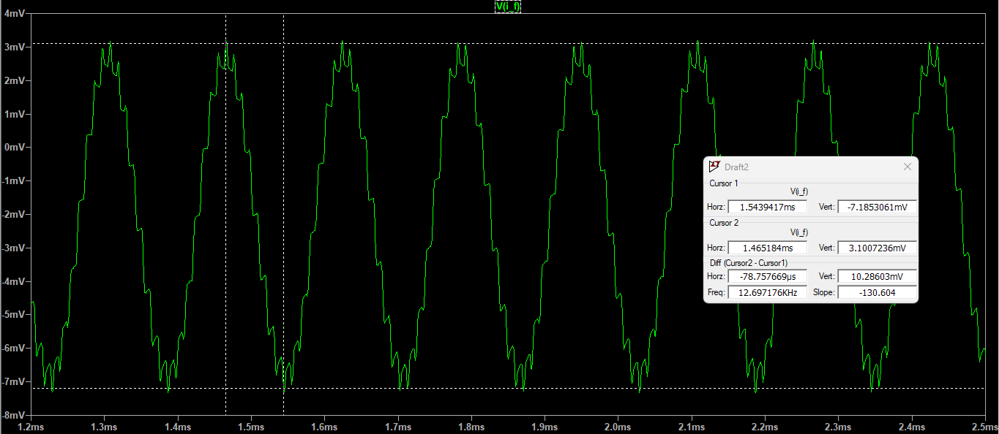
Final If Signal(Amplitude)

Slide 59

Final If Signal(Frequency)

Slide 60
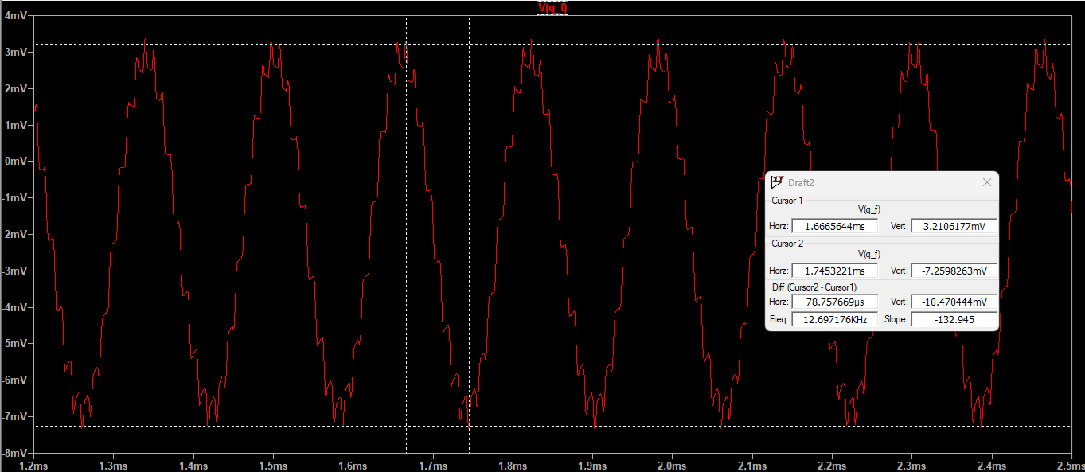
Final Qf Signal(Amplitude)

Slide 61

Final Qf Signal(Frequency)

Slide 62
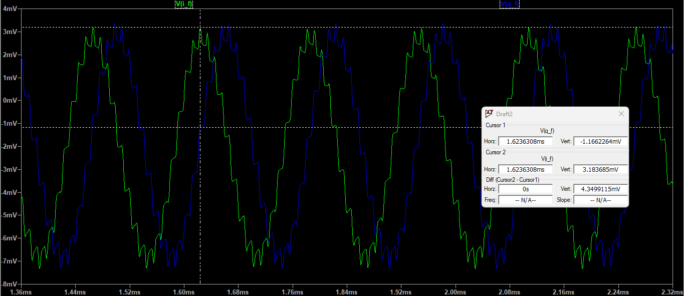

Slide 63
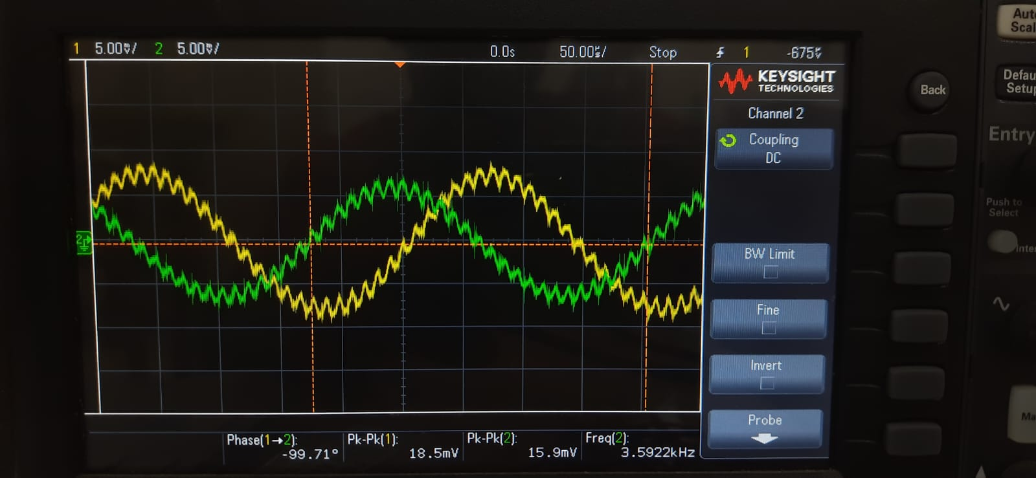

Slide 64
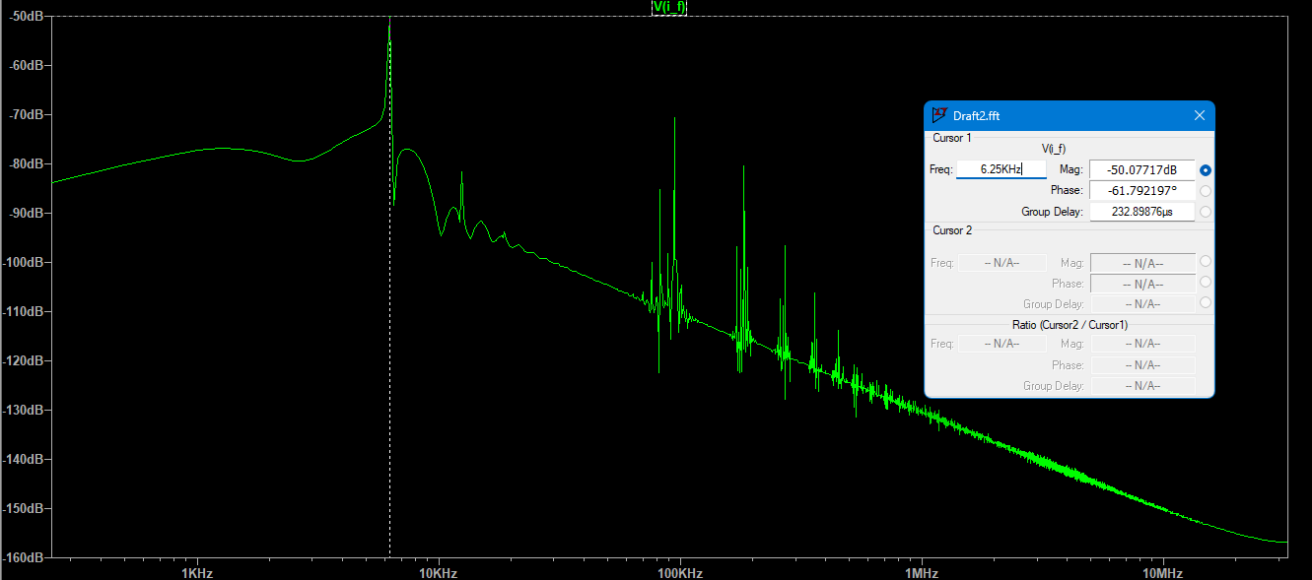
FFT of If

Slide 65
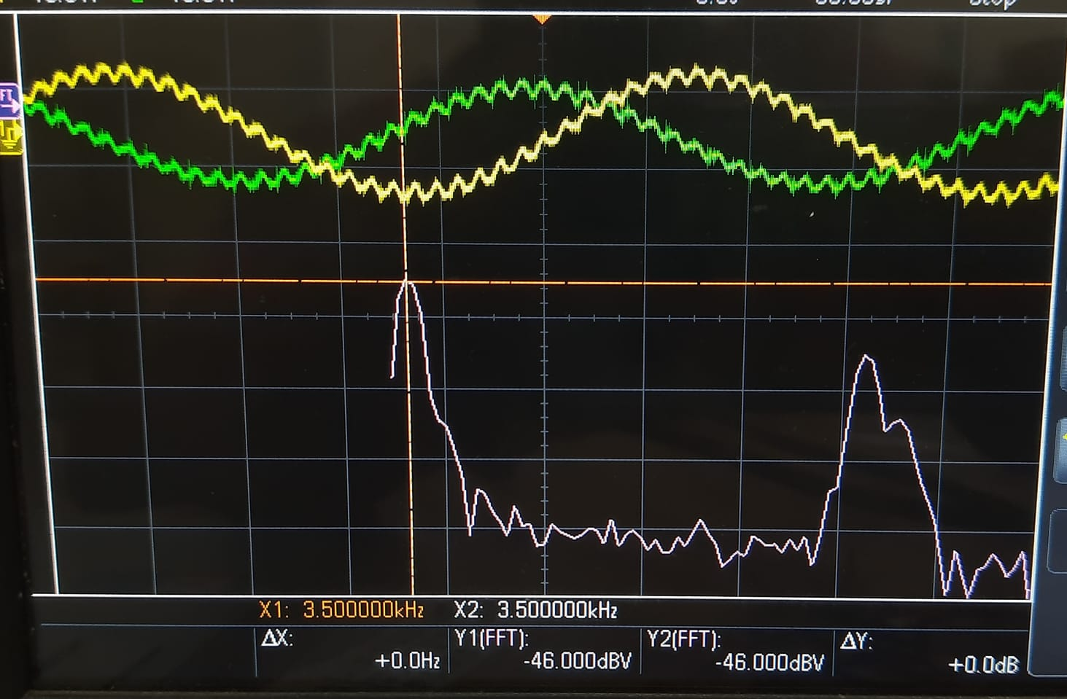

Slide 66
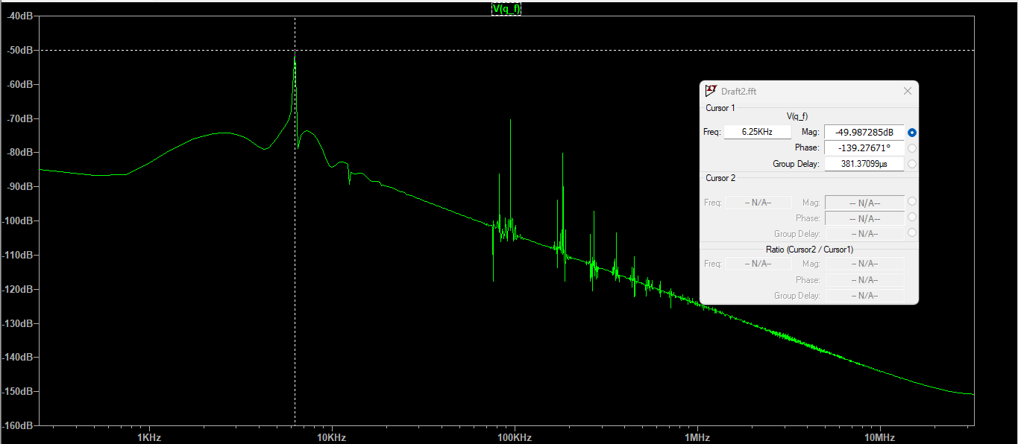
FFT of Qf

Slide 67
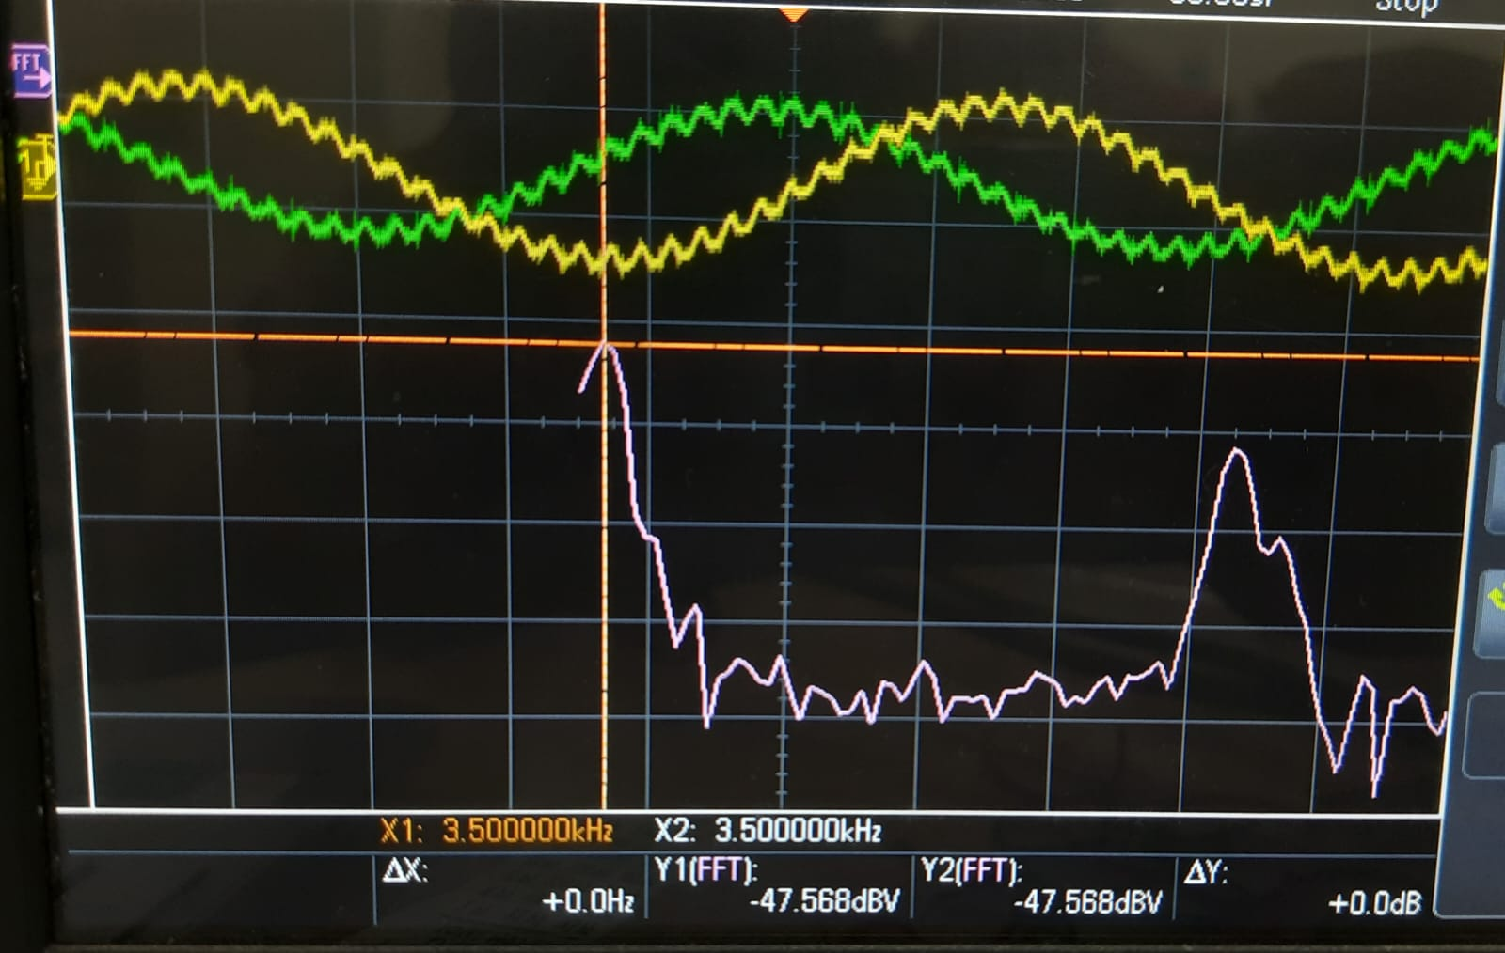

Slide 68
Observed Phase Difference
98.678

